Slide 1
Module 1: An Overview of United Nations Peacekeeping Operations
Lesson
1. 8
Mission Partners

Slide 2
Relevance
Peacekeeping personnel are expected to work with:
National partners – key stakeholders
UN Country Team (UNCT)
External partners
UN Core Pre-Deployment Training Materials 2017

Slide 3
Learning Outcomes
Learners will:
List types of mission partners and examples
Explain why national partners are key partners
Explain why the UNCT is important
Describe the UN’s “integrated approach” and the benefit
UN Core Pre-Deployment Training Materials 2017

Slide 4
Lesson Overview
Importance of Mission Partners Working Together
Different Mission Partners
National Partners
UN Partners
External Partners
UN Core Pre-Deployment Training Materials 2017

Slide 5
Learning Activity
1.8.1
Football/Cricket
Instructions:
Think about a sport
Discuss different players’ contributions towards the “goal”
Draw comparisons between the mission and different players in a host country
Time: 5 minutes
Brainstorming: 3 minutes
Discussion: 2 minutes
UN Core Pre-Deployment Training Materials 2017

Slide 6
1. Importance of Mission Partners
Working Together
INDICATIVE POST-CONFLICT TASKS
Infrastructure
Employment
Economic governance
Civil administration
Elections
Political process
Security operations
DDR
Rule of law
Human rights
Capacity building
Humanitarian assistance
STABILIZATION
PEACE
CONSOLIDATION
LONG-TERM RECOVERY
& DEVELOPMENT
World Bank/IMF
UN Peacekeeping
UN Country Team, Donors
Local Institutions
ICRC/NGOs
UN Core Pre-Deployment Training Materials 2017

Slide 7
2. The Different Mission Partners
National Partners
UN Partners
External Partners
UN Core Pre-Deployment Training Materials 2017

Slide 8
Learning Activity
1.8.2
Mission Partners
Instructions:
Think about a country with a UN peacekeeping mission
Brainstorm examples of UN, national and external partners
Time: 5 minutes
Brainstorming: 3 minutes
Discussion: 2 minutes
UN Core Pre-Deployment Training Materials 2017

Slide 9
3. National Partners
State actors: host government, ministries, military, police
Non-state actors: civil society, non-governmental organizations (NGOs), private sector
UN Core Pre-Deployment Training Materials 2017

Slide 10
Why “Key Partners”?
Have the most at stake – beneficiaries, clients
Efforts ensure host government can meet the needs of its people
Promotion of national and local ownership is a success factor
UN Core Pre-Deployment Training Materials 2017

Slide 11
State - Host Government
Most important non-UN actor
Interactions on many levels
Partnerships with other state actors – national military, police
Include variety of political views and social groups
UN Core Pre-Deployment Training Materials 2017

Slide 12
Non-State - Civil Society
A community of citizens linked by common interests and activities
Political parties, national NGOs and other associations, communities or groups of citizens
Include men and women, marginal and vulnerable people
UN Core Pre-Deployment Training Materials 2017

Slide 13
4. UN Partners
UN Core Pre-Deployment Training Materials 2017

Slide 14
Why Important?
Knows host country and conflict situation
Relationships with national partners
Continuity for peacebuilding activities
Financial resources and expertise
UN Core Pre-Deployment Training Materials 2017

Slide 15
Integrated Approach
UNCT
Scope of ISF
Humanitarian
Peace & Security
Development
UN PKO
UNCT
UN Core Pre-Deployment Training Materials 2017

Slide 16
5. External Partners
International organizations
International Committee of the Red Cross (ICRC)
Individual Member States
Intergovernmental Organizations
UN Core Pre-Deployment Training Materials 2017

Slide 17
Why is Coordination & Cooperation
Important?
Large number of external partners
Separate but overlapping mandates and expertise
Independent agendas
Different timelines and work methods
UN Core Pre-Deployment Training Materials 2017

Slide 18
International Organizations
Includes NGOs with an international presence
Can provide humanitarian assistance
UN Core Pre-Deployment Training Materials 2017

Slide 19
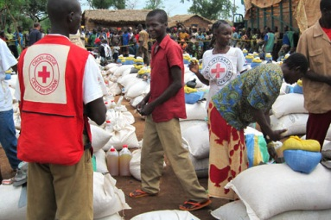
International Committee of the Red Cross
Important humanitarian actor
Mandate: protect and assist victims of armed conflict
“International legal personality”
UN Core Pre-Deployment Training Materials 2017

Slide 20
Individual Member States
Diplomatic community
Bilateral donors
Contractors
Non-UN led military forces
UN Core Pre-Deployment Training Materials 2017

Slide 21
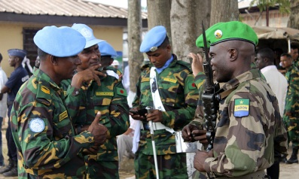
Intergovernmental Organizations
Regional and sub-regional organizations
Differing roles and relationships with the UN
Peace enforcement operations
UN Core Pre-Deployment Training Materials 2017

Slide 22
Learning Activity
1.8.3
Partners Working Together
Instructions:
Consider the needs of a country after conflict
Brainstorm tasks carried out by the international community and the mission
Identify tasks addressing critical, short term needs and long term needs
Time: 10 minutes
Group work: 5-7 minutes
Discussion: 3 minutes
UN Core Pre-Deployment Training Materials 2017

Slide 23
Summary of Key Messages
Mission partners – national, UN, external
National partners are key partners – impacted by and have an impact on achieving mandate
UNCT is a valuable resource
“Integrated approach” involves UN system working together to realize a common strategic vision – cooperation increases and sustains impact
UN Core Pre-Deployment Training Materials 2017

Slide 24
Questions
UN Core Pre-Deployment Training Materials 2017

Slide 25
Learning Activity
Learning Evaluation
UN Core Pre-Deployment Training Materials 2017

